Slide 1
Introduction to Image Analysis with FIJI
6. Image Registration, Tracking, and Stitching
Gayathri Nadar, Noreen Walker
Scientific Computing Facility, MPI-CBG
3.-7.5.2021
Topics:
Image Registration
Time sequence analysis: Tracking
Image Stitching
With material from:
Robert Haase
Benoit Lombardot

Slide 2
Course schedule
Day 1 (Mon 3.5.)
Image basics, visualization, measurements
Spot detection
Segmentation (start)
Day 2 (Tue 4.5.)
Visit LMF
Segmentation (cont’d)
Mathematical background: image filters, morphology
Day 3 (Wed 5.5.)
Advanced segmentation: Machine learning with Ilastik
IJ Macro (start)
Day 4 (Thu 6.5.)
IJ Macro (cont’d)
3D data: visualization and analysis
Day 5 (Fri 7.5.)
Image registration, image stitching
Time sequence analysis and tracking
Good practices

Slide 3
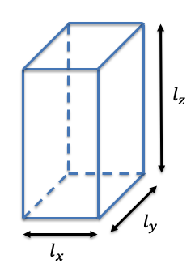
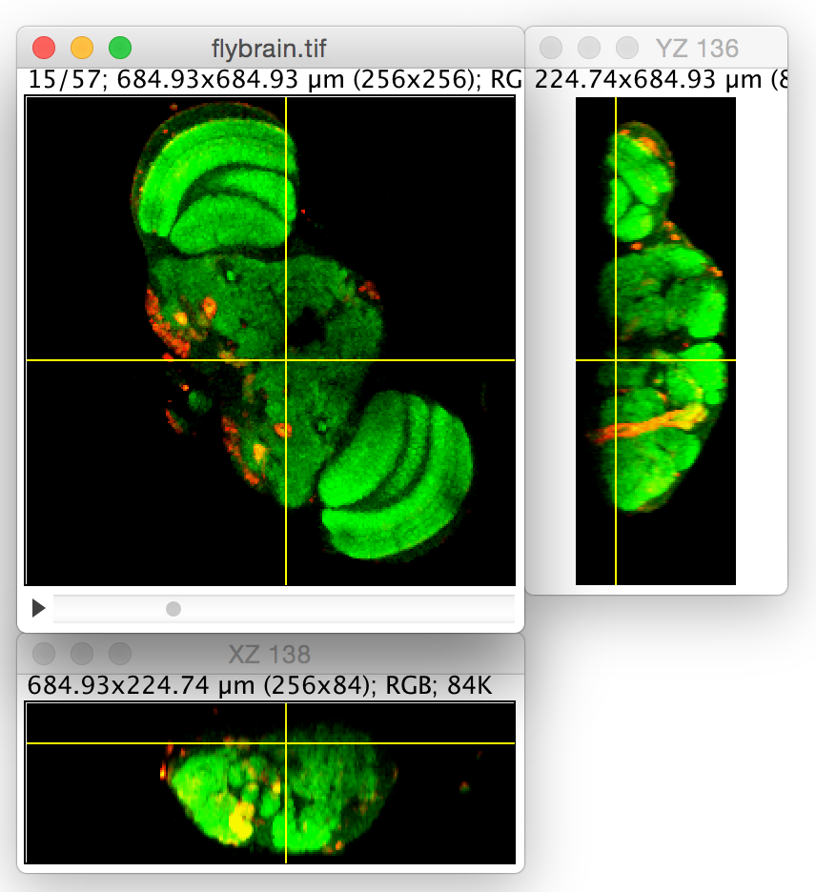
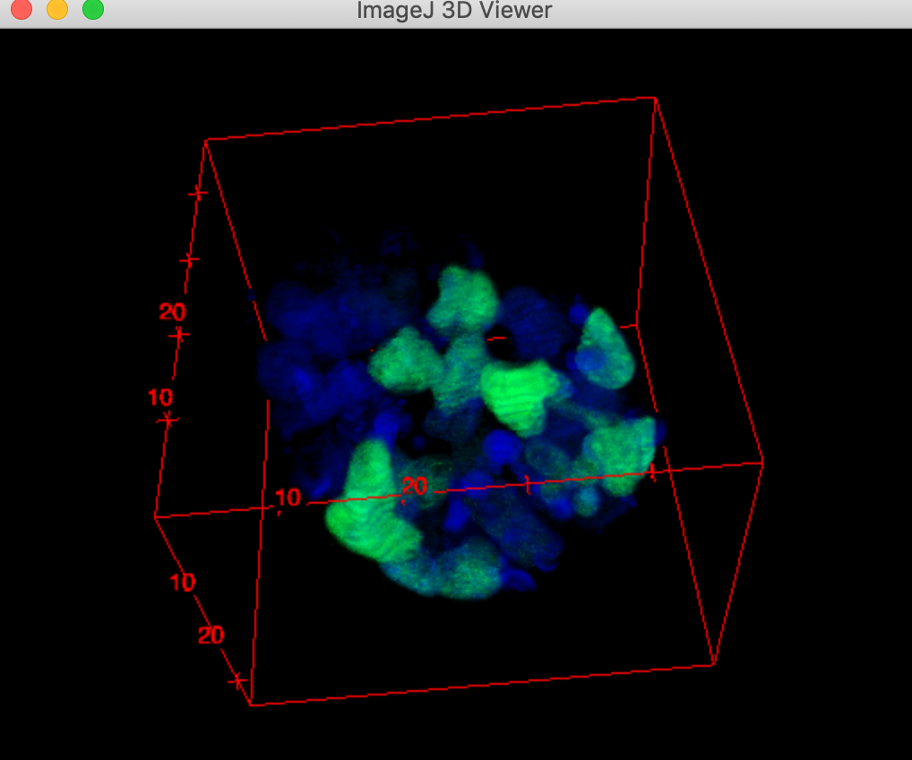
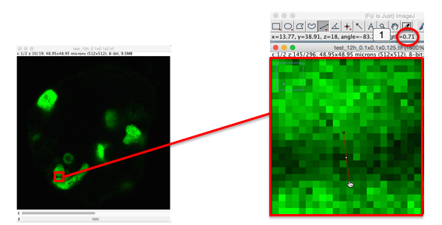
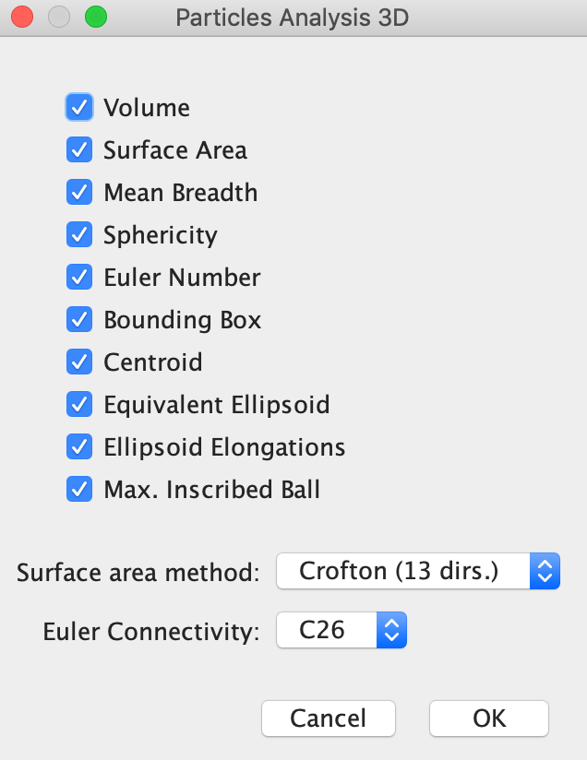
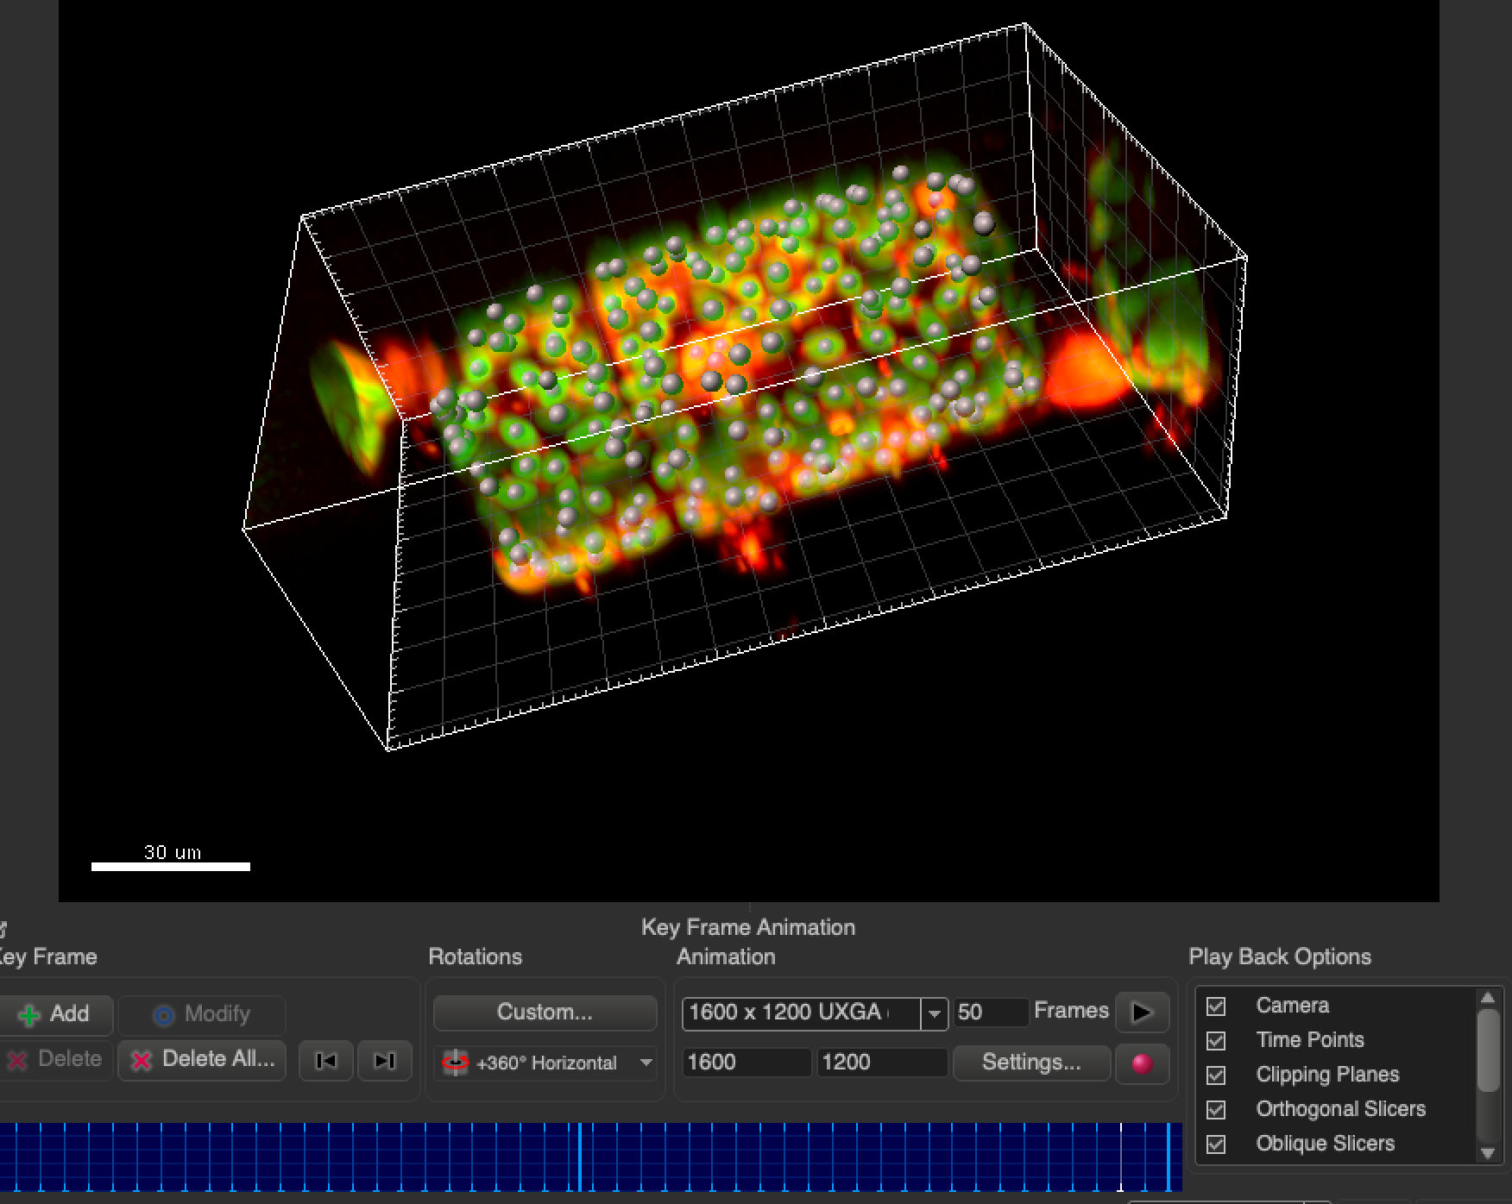
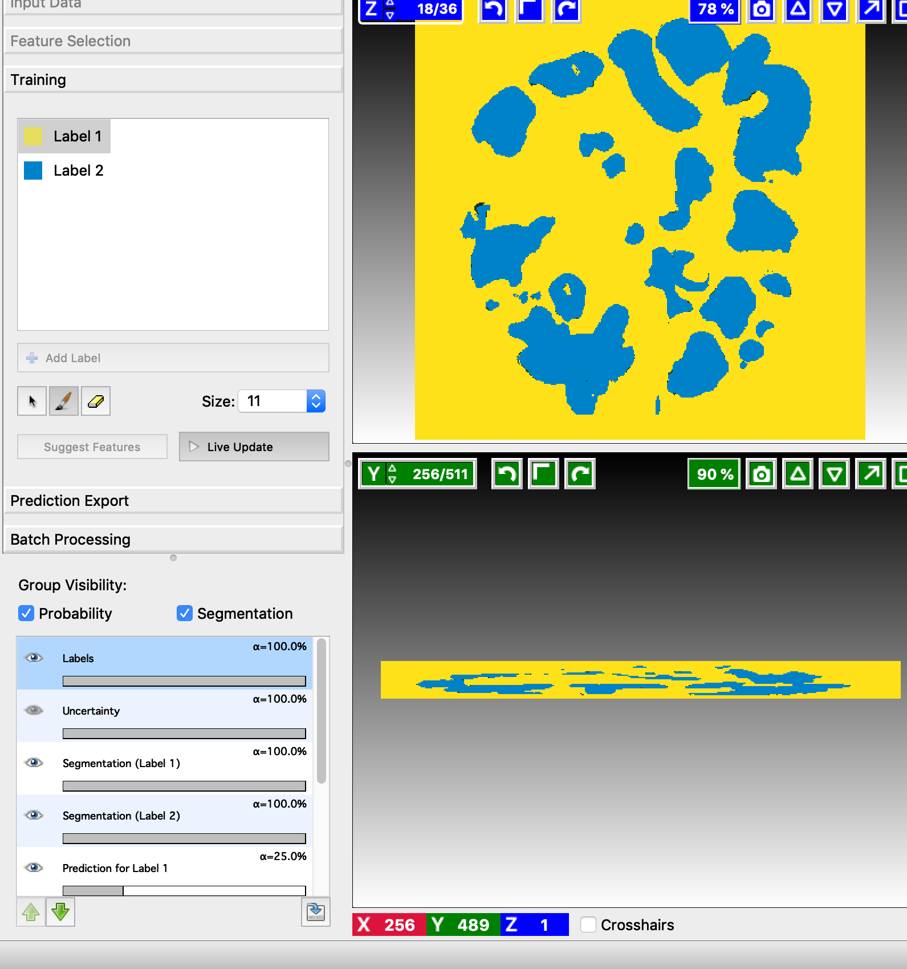
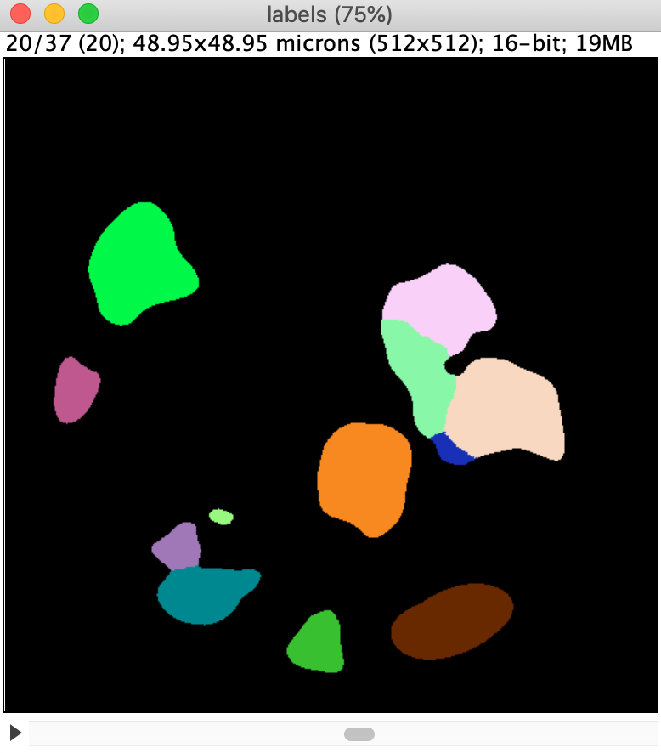
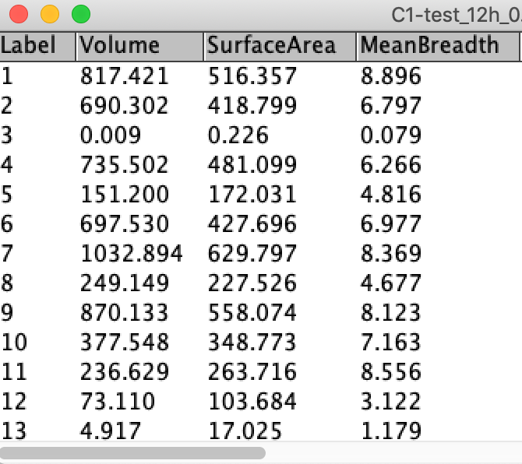
Recap: 3D Visualization & Analysis
3D Data
Visualization
Anisotropy Required sampling
2D slicing
3D
Analysis
Other tools
3D segmentation and measurements

Slide 4
Overview
Image registration
Drift corrections in images
StackReg tool in FIJI
Time sequence analysis
Tracking
Tracking in FIJI: TrackMate
Stitching
Stitching tiles in FIJI: Grid-collection plugin

Slide 5
Recap: Image dimensions
Images have up to 5 dimensions.
2D 3D (z-stack)
+ time + channels
A dataset can additionally consist of multiple tiles or views
Notes:
Now we add time to our data!

Slide 6
Image registration
y
x

Slide 7
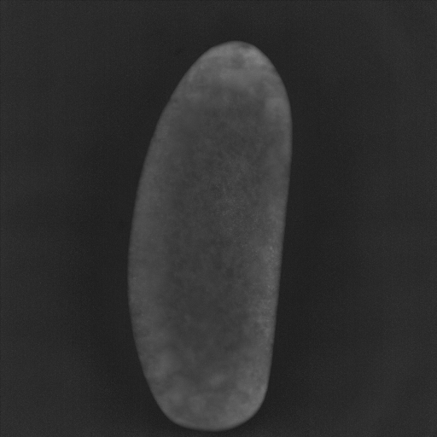
Motivation
Time lapse data is beneficial for many experiments
Study how objects grow with time, e.g. embryo developments
Tracking objects, e.g. cell migrations
Also comes with challenges
Sample drifting
Cells moving out of field
Reduced signal with time
…
Session goal: drift/motion correction in images
Using image registration: fix a frame, “register” other frames to this
Drifting sample

Slide 8
Image Registration
“Image registration is the process of transforming different sets of data into one coordinate system.”
Source: Wikipedia
y
x
x
x
Technically
finding corresponding structures
determining the optimal transformation to correct the misalignment of the images and
apply the transformation

Slide 9
Terminology
Most commonly, one image is moved/rotated/… to match it in the coordinate system of the other image.
y
x
Reference,
source or
fixed image
Target,
subject or
moving image

Slide 10
Registration Strategies
versus
Feature-based
Intensity-based
Mean squared error of pixel values
MSE = 2000
MSE = 1900
System of linear equations
Optimisation
MSE = 500
MSE = 0

Slide 11
Types of Misalignments
There are many facets of misalignments
The less we observe, the easier is the correction
aligned image
translation
rotation
isometric scaling
scaling
shearing

Slide 12
Spatial Transformations
Spatial transformations help to correct for the misalignments between fixed and the moving images
fixed
moving
Translation only
Translation
+ Rotation
Rigid transformation
Translation
+ Rotation
+ Isometric scaling
Geometric similar transformation
Translation
+ Rotation
+ scaling
[+shearing]
Affine transformation
Notes:
Today we look at translation = drift

Slide 13
Quiz 1
By applying image registration from frame to frame, we can do drift correction.
Uncorrected
Corrected
Which transformation do we need to apply?
Translation
Rigid
Affine

Slide 14
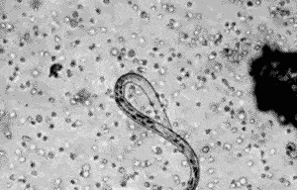
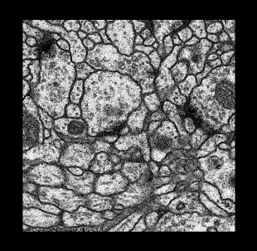
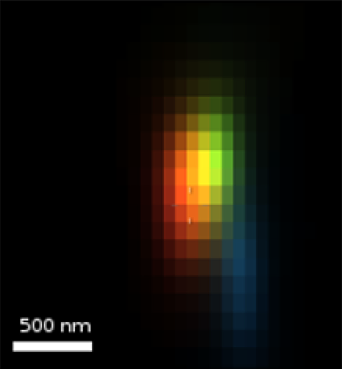
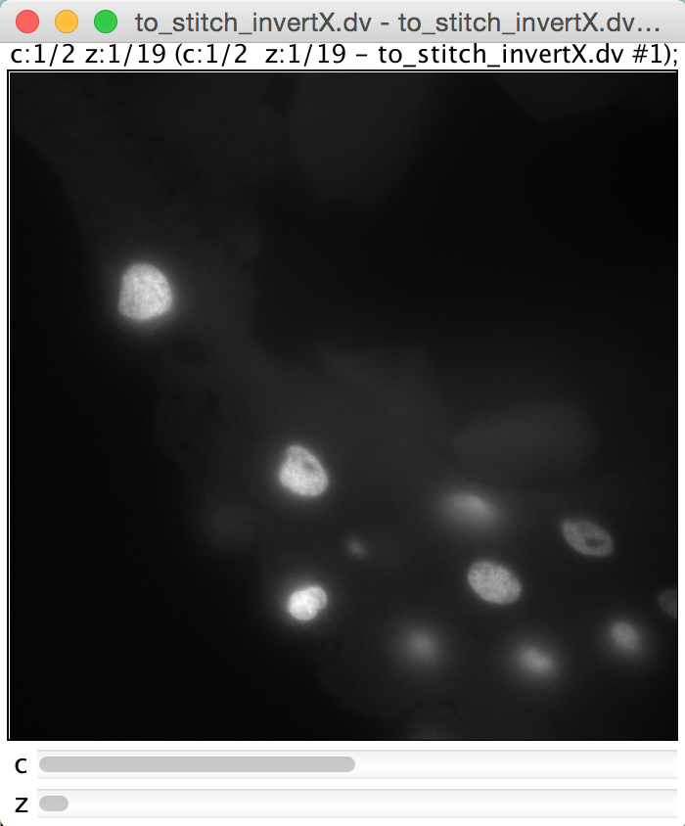
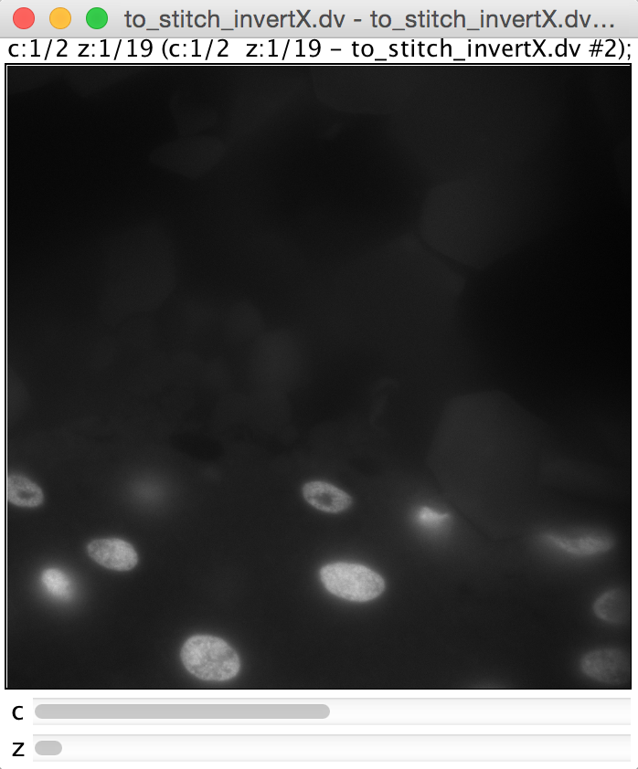
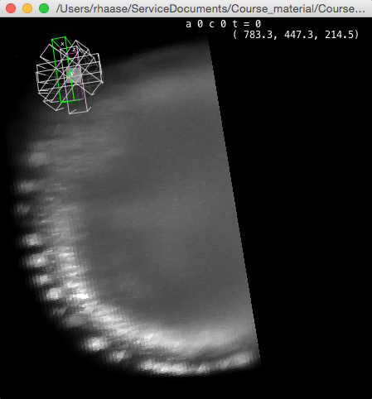
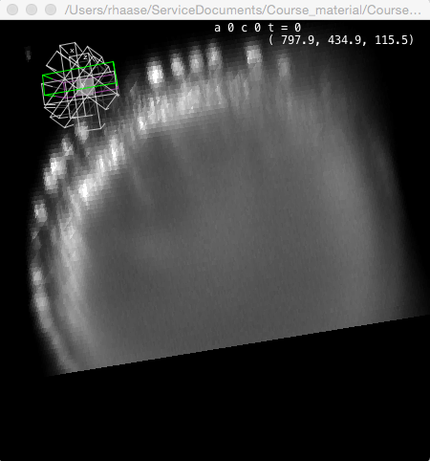
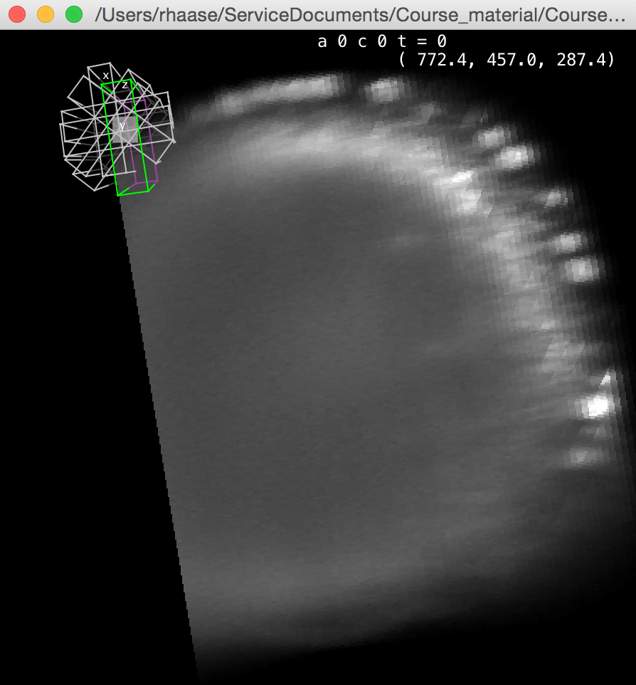
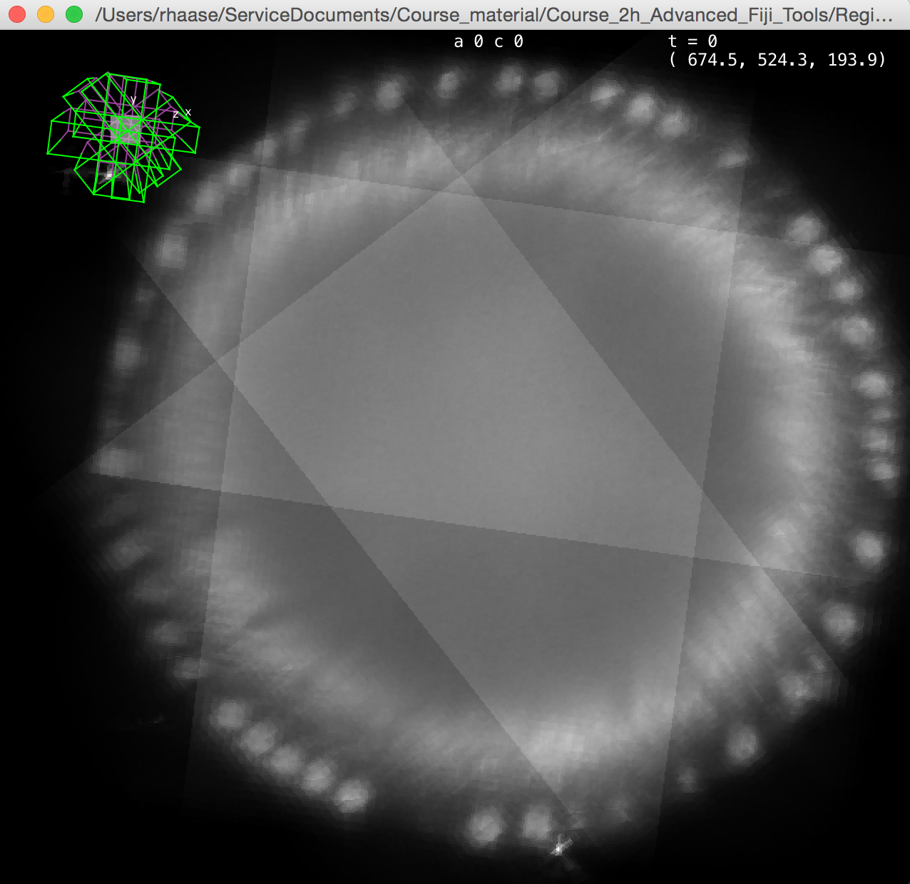
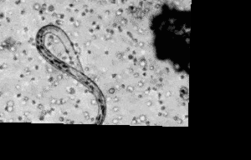
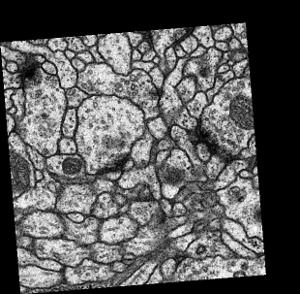
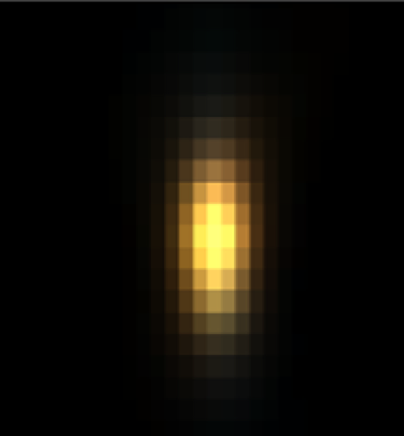
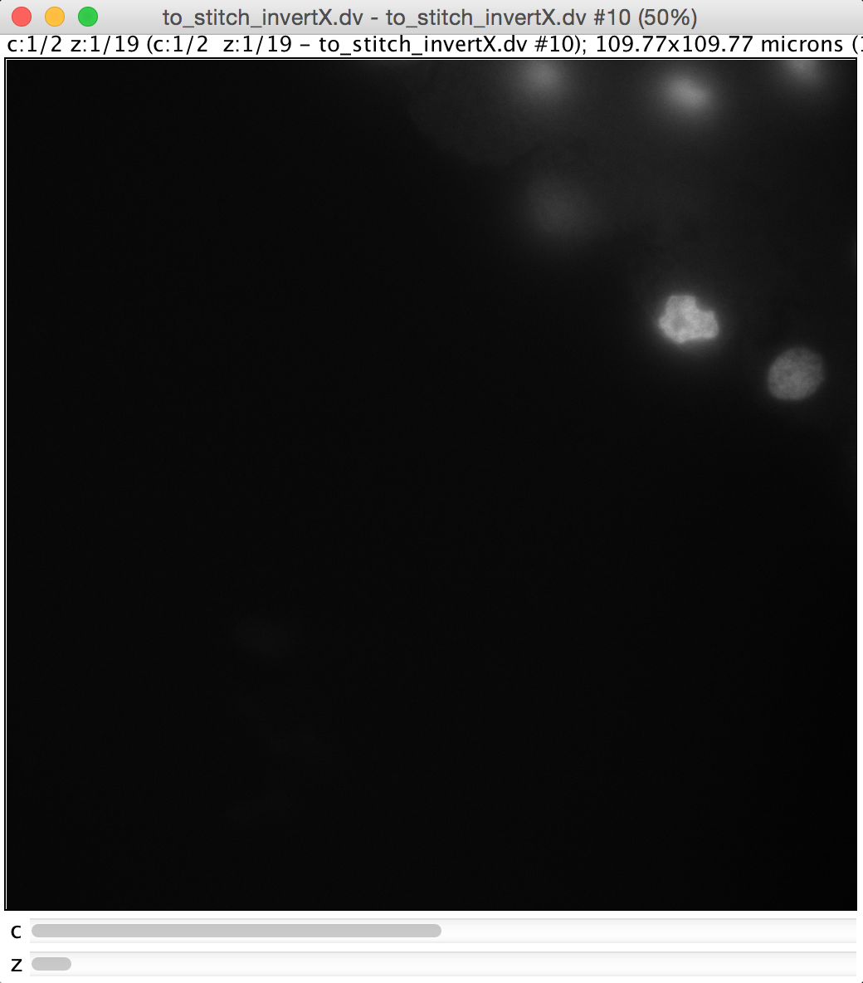
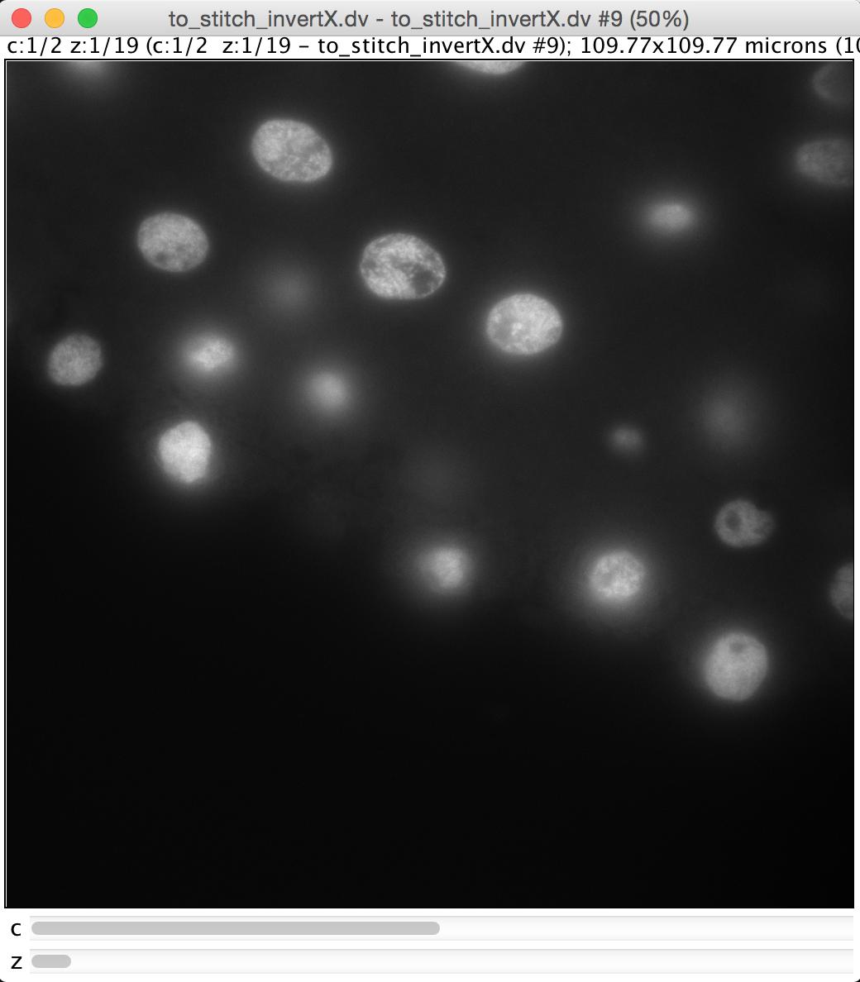
Registration: Many use cases
Registration appears in many image pre-processing steps, such as
Chromatic aberration correction
Motion correction
Slice alignment
Stitching
Multiview reconstruction
Original
Image source: http://www.zmescience.com/medicine/gifs-biology-human-body/
Image source: http://imagej.net/Register_Virtual_Stack_Slices
Image source: https://svi.nl/ChromaticAberrationCorrector
Image source: Carine Stapel (Vastenhouw lab)
Image source: https://fiji.sc/ Multiview-Reconstruction
Now we look at motion/drift correction
Later: Stitching

Slide 15
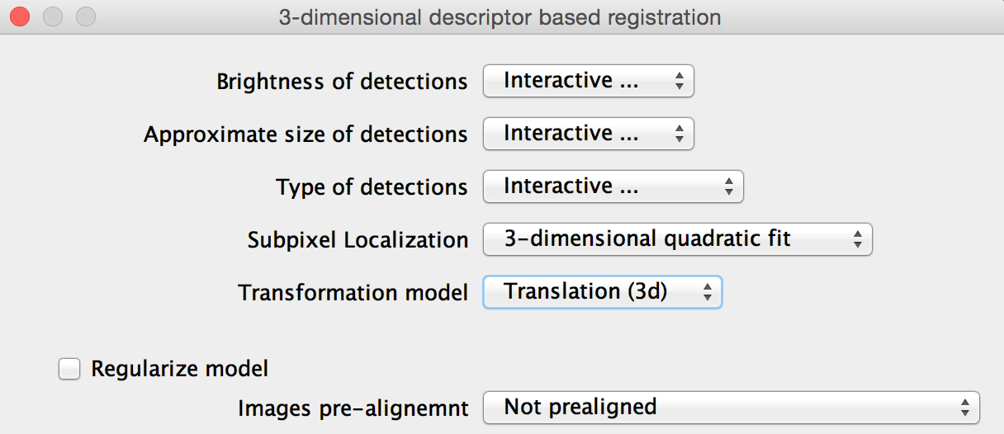
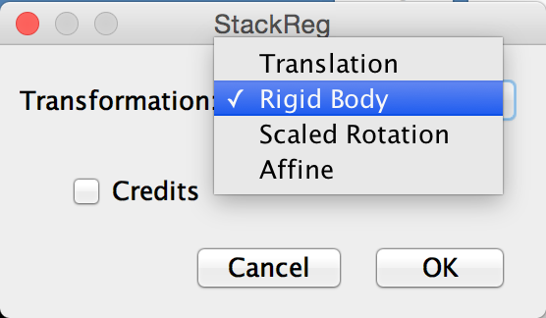
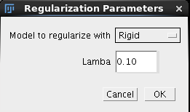
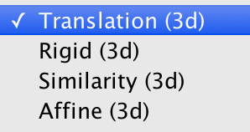
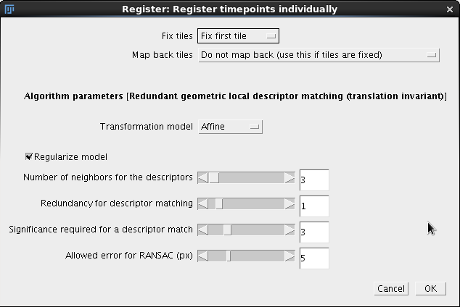
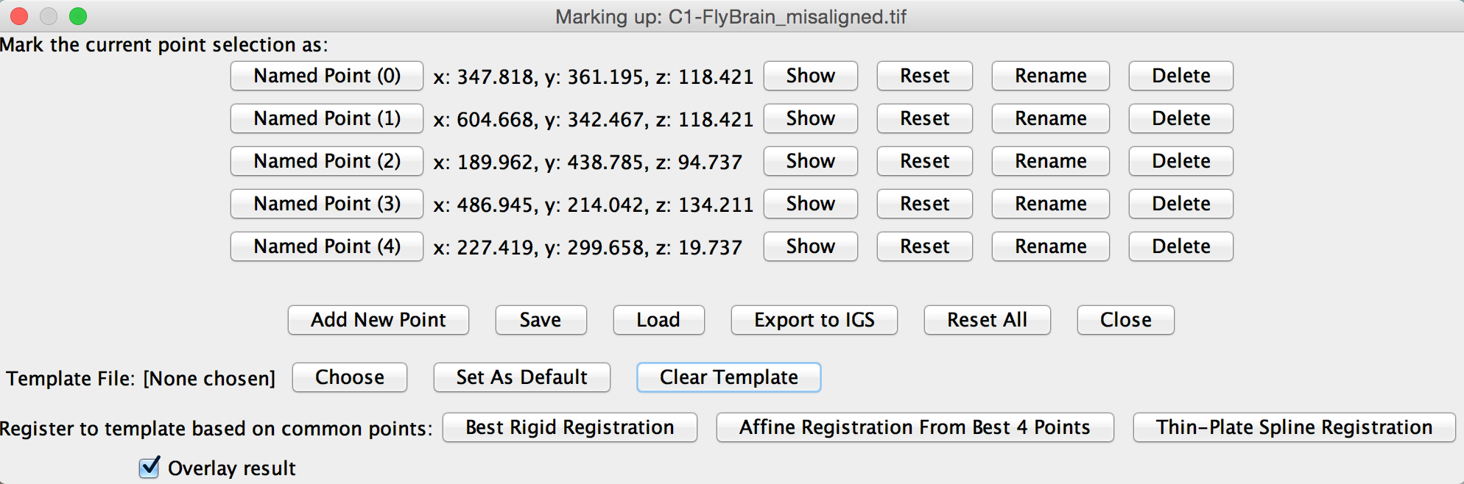
Spatial Transformations: in Practice
These terms are variously used in registration software

Slide 16
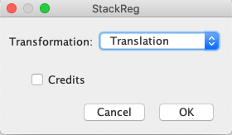
Registration in FIJI: StackReg Tool
Register a stack of image slices
Slice visible or set by user = fixed image
All the other slices in the stack = moving
Plugins > Registration > StackReg
http://bigwww.epfl.ch/thevenaz/stackreg/

Slide 17
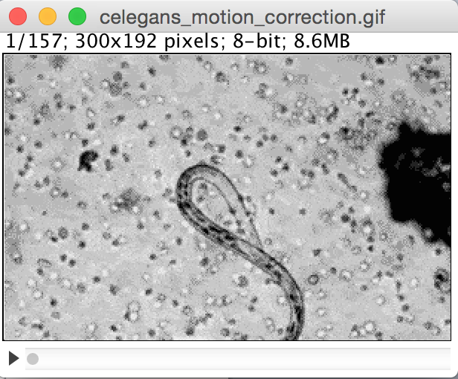
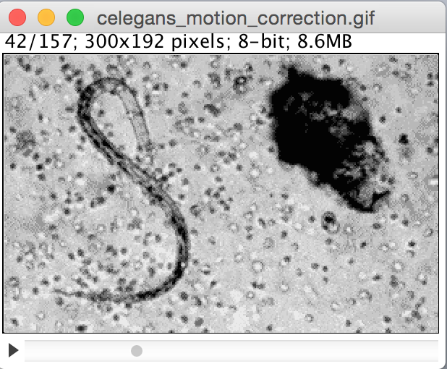

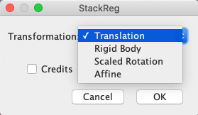
Demo/Hands-on: Drift Correction using StackReg
Open celegans_motion_correction.gif
Select a frame, where the investigated object is as centred as possible.
Plugins > Registration > StackReg

Slide 18
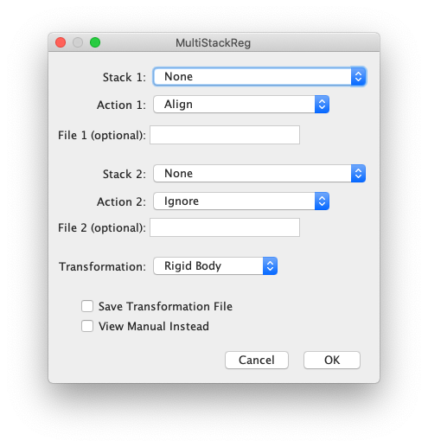

Other Registration Tools in FIJI
Register Virtual Stack Slices
Ignacio Arganda-Carreras
FIJI plugin
Useful for big data
MultiStackReg
Brad Busse
FIJI plugin
Multichannel images

Slide 19
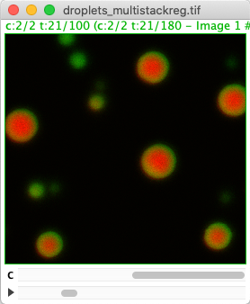
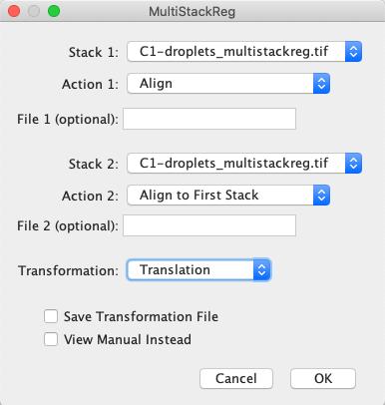
Exercise: MultiStackReg
MultiStackReg allows you to register two stacks. For e.g. -
Register one channel to another
Exercise:
Open the image droplets_multistackreg.tif
Use slider to see the drift in action.
Duplicate the image
Split channels
Launch MultiStackReg plugin
Plugins > Registration > MultiStackReg
Choose ch1 as Stack 1 and align ch2 to ch1
Select appropriate transformation
Merge channels
Compare with the original image
Tip:
Don’t forget to set the correct “reference” frame on Stack 1 (as with StackReg)
Image source: Basusree Ghosh (Tang lab)

Slide 20
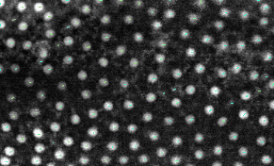
Time sequence analysis

Slide 21
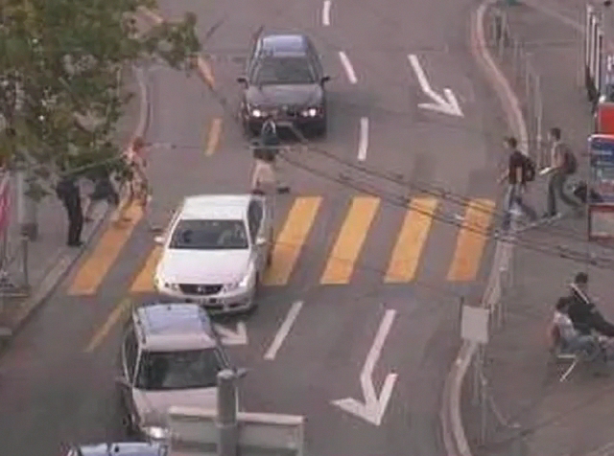
Time sequence analysis: Tracking
Tracking: ”following moving objects”
Active research field
Algorithms
Applications
High computational effort (complexity)
High performance computing
Goals
Measure track properties (speed, velocity)
Study spatio-temporal relationships
Single particle tracking
Building cell lineages during development
Session goal: tracking objects in images
Source: Konrad Schindler, Computer Vision Lab, ETH Zuerich
http://www.vision.ee.ethz.ch/datasets/
Notes:
Now we have corrected for drift, next -> track objects of interest and measure specific properties

Slide 22
Tracking
Cell tracking in a nutshell
Combines object detection and matching (or linking)
Steps
Detect objects at all time frames
Match/ link objects between consecutive time frames
matching
matching
matching
Courtesy of Florian Jug, MPI CBG
Segmentation
Segmentation
Segmentation
Segmentation
t-2
t=1
t=2
t=3
t-1
t
t+1
Assume 99% correct

Slide 23
Tracking
Tracking needs many decisions.
Let’s assume we have:
about 1000 objects
500 time points (frames)
Number of decisions to be made – an approximation
1000 + 499 * (1000+1000² ) = 499.500.000 (!!!)
More objects and timepoints -> more computationally expensive
Courtesy of Florian Jug, MPI CBG
Objects at
t = 1
Remaining
time pts
Objects to be matched
from t to t+1

Slide 24
Tracking
Tracking errors propagate
High accuracy at the beginning does not guarantee perfect output at the end
As time points increase, the probability to err is high
t → t + 1: Assume 99% correct matching of objects
Time points: 100
P(‘correct lineage’) ≈ 0.99⁹⁹ ≈ 37%
Time points: 500
P(‘correct lineage’) ≈ 0.99⁴⁹⁹ ≈ 0.07%
Courtesy of Florian Jug, MPI CBG

Slide 25
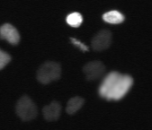
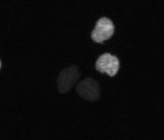
Quiz 2
Tracking errors: Erroneous segmentation
)
How many objects do you see?
1
2
Courtesy of Florian Jug, MPI CBG

Slide 26
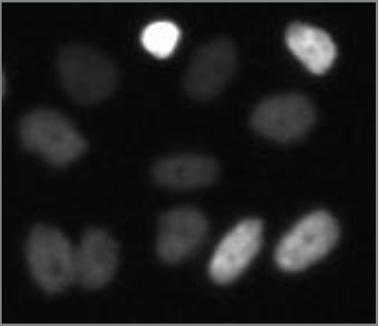
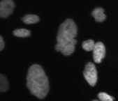
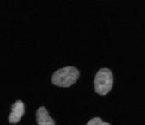
Tracking: Error Sources
Erroneous segmentation
Missed objects (under-segmentation)
Spurious objects (over-segmentation)
Courtesy of Florian Jug, MPI CBG

Slide 27
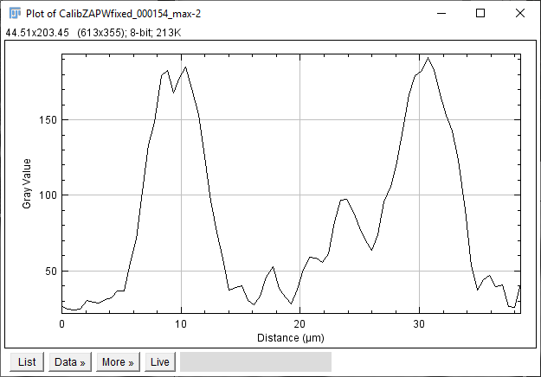
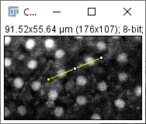
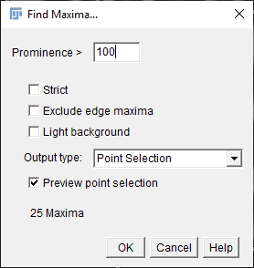
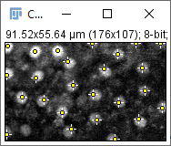
Spot-detection: Track maxima
Alternative to segmentation; especially when tracking is the goal
The maxima finder algorithm uses a tolerance (minimum valley depth)
Tolerance: 120
Tolerance: 30
Tolerance: 15
In Fiji: Process > Find maxima…
Notes:
In you are only interested in “track” properties like lifetime, velocity, etc. detecting maxima and tracking them should be enough

Slide 28
Linking / matching
Linking (also “matching”) is the process of connecting spots to tracks by adding edges.
t
t+1
t+2
Linking is a linear assignment problem (LAP)
Costs are associated for linking objects, merging tracks, splitting, etc.
Optimized by solving for the solution with minimal costs
Courtesy of Florian Jug, MPI CBG

Slide 29
Tracking Terminology
Lineage tree (“graph”)
“Track” (TrackMate)
“Edge” / “Link”
“Node” / “Spot” (Segments)
“Leaf”
“Root”

Slide 30
Tracking Terminology
Spot detection + linking
t - 1
t
t + 1
Segmentation + matching
t - 1
t
t + 1

Slide 31

Tracking in FIJI: TrackMate

Slide 32
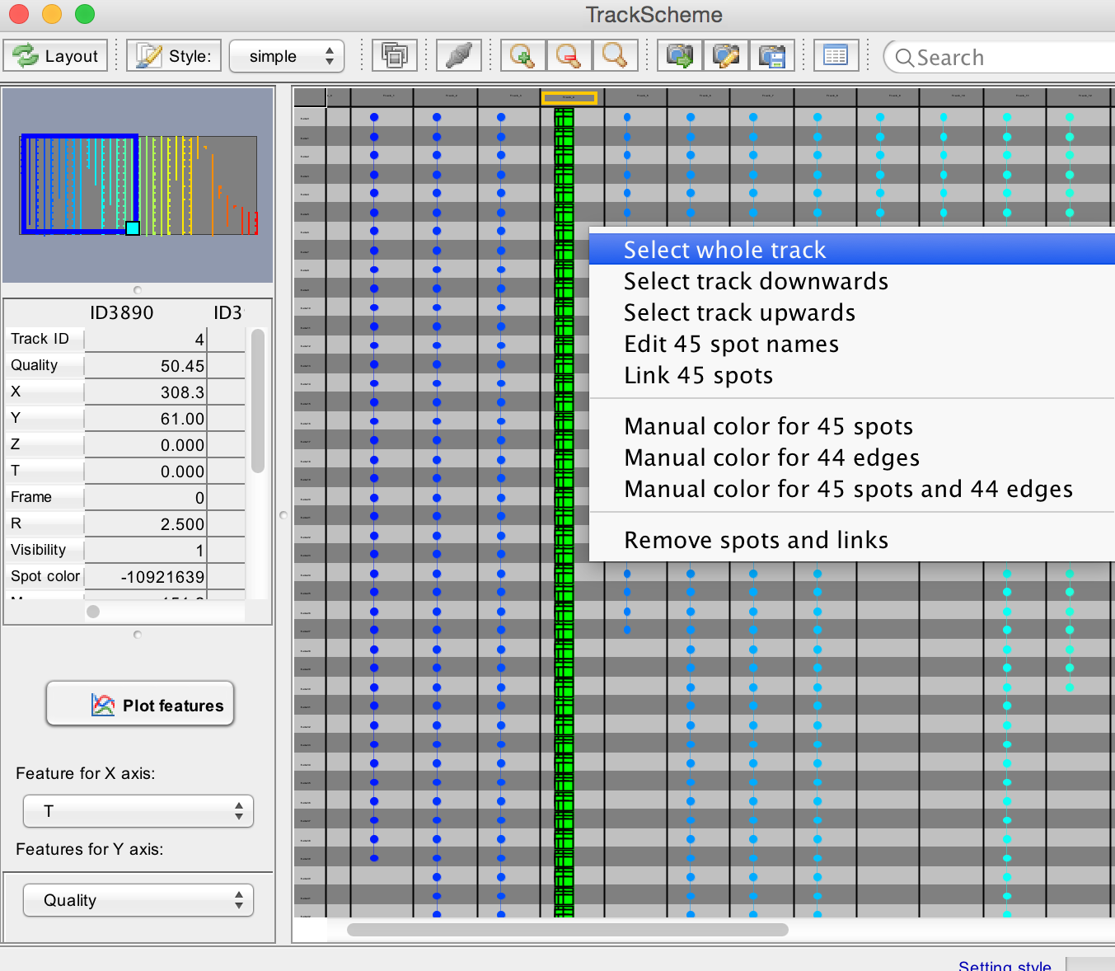
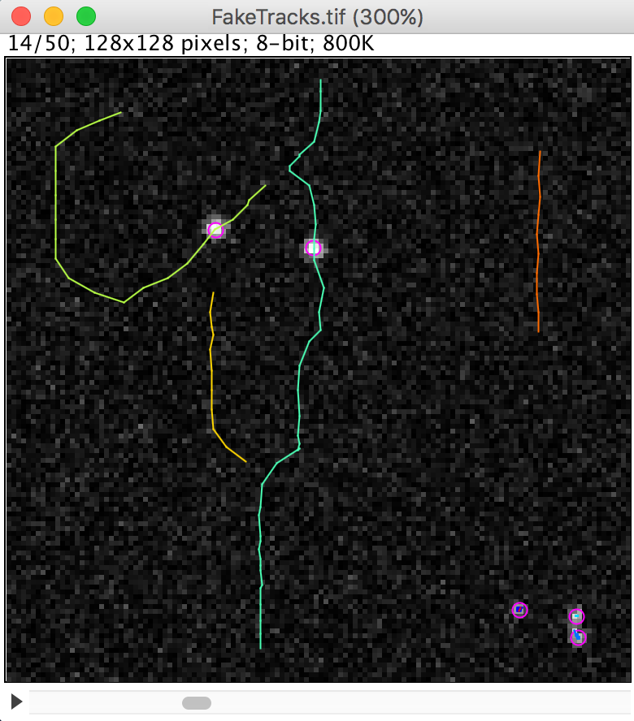

Tracking in FIJI: TrackMate
Go-to tool for tracking in FIJI
Powerful
Works with 2D and 3D data
Maintained and well documented
Macro/script support
Active support on forum
Jean-Yves Tinevez

Slide 33



TrackMate: Step-by-step
Loading tracking image data
Reduce image data to the necessary by outlining an interesting area (1). The larger your file is, the longer the processing will take. Select a time range to reduce even further (2).
Image > Duplicate…
1
2

Slide 34


TrackMate: Step-by-step
Launch TrackMate
Plugins > Tracking > TrackMate
1

Slide 35





TrackMate: Step-by-step
Difference-of-Gaussian based spot detection
Configure blob diameter and threshold. Prefer “some to many” instead of “some missing”.

Slide 36


TrackMate: Step-by-step
In case there is a peak on the left of the quality diagram, put a threshold to exclude it. The less spots you continue to process, the faster tracking will work.
1

Slide 37



TrackMate: Step-by-step
Use the time scroll bar to check various time points.
Finding the right parameters for all time points might be challenging.
1
2
3

Slide 38


TrackMate: Step-by-step
If spot detection was wrong, consider going back to square one. Repeat all necessary steps.
1
2

Slide 39




TrackMate: Step-by-step
Go through the following steps again. Repeat quality control.

Slide 40



TrackMate: Step-by-step
Linking
Configure maximum distance for two spots (in subsequent time points) to be considered as the same spot. (1)
Define maximum distance between spots which are not present in subsequent time points (2)
The frame gap corresponds to the number of frames where the spot might not be present.
Use Fijis line tool to measure distances in the image (3/4).
3
4
1
2

Slide 41


TrackMate: Step-by-step
Configure maximum distance for two spots to be considered as split event.
If merging is biologically reasonable, turn merging on.
1
2

Slide 42




TrackMate: Step-by-step
Visualize track properties
Visualize track properties (1) to find regions (and time ranges) where something went wrong.
1

Slide 43


TrackMate: Step-by-step
Filtering tracks
Add filters on tracks
Using the + and – buttons
Selector what to filter for
Above/below choice
Inspect resulting tracks – why are there so little?
2
3
1

Slide 44



TrackMate: Step-by-step
Trackscheme
Use the TrackScheme (1) to visualize lineages. Are they reasonable?
1

Slide 45

Demo: TrackMate

Slide 46
More tools/ plugins

Slide 47
More tools for Tracking
Mastodon
Tobias Pietzch (CSBD), Jean-Vyes Tinevez
Tracking in big-data
In-beta
ParticleTracker (MOSAIC SUITE)
MOSAIC Group, CSBD
FIJI plugin for tracking 2D/ 3D points
MaMut
Jean-Vyes Tinevez
FIJI plugin for annotation of big-data
Notes:
MaMuT itself does not ship any fully-automated or tracking algorithm. It is meant for manual or semi-automatic annotation. A semi-automated segmentation can help you generating quickly lineage branches from single cells.

Slide 48




Add-on: Temporal color code
Fiji tool to color code objects with selected LUT over time
Great for visualization purposes
Input: 2D/ 3D time-series
Image > Hyperstacks > Temporal Color-Code
Output:
1. RGB color-coded
2. Color scale
https://imagej.net/Temporal-Color_Code

Slide 49


Add-on: Bleaching Correction
Photo-bleaching: fluorescence decay from the samples with time
Common issue with time-lapse data
Resulting intensity measurements might not represent true values
In FIJI, Image > Adjust > Bleach Correction offers solutions for bleach correction
For details on the methods: https://f1000research.com/articles/9-1494
https://imagej.net/Bleach_Correction

Slide 50


Summary
Registration
Tracking
y
x

Slide 51
Exercises
Indicate in the online docx whether you are finished and if you need a live demo of difficult steps.

Slide 52





Exercise: Track spots using TrackMate
Goal: Tracking spots in SwimmingAlgae.tif and visualize trackscheme
Open SwimmingAlgae.tif
Launch TrackMate
Check if the calibration is correct!
Step 1: Blob detection
Use the Log detector to detect spots
Use line tool to measure spot diameter (median filter is useful to remove noise)
Use preview!
Hint: Check results in several frames

Slide 53

Exercise: Track spots using TrackMate
Step 2: Visualize spots
Set filters if necessary to discard spurious spots
Play around with the “set color by” option
Adding filters

Slide 54




Exercise: Track spots using TrackMate
Step 3: Linking
Use LAP Tracker
Frame to frame linking max distance: maximum distance for two spots (in subsequent time points) to be considered as the same spot.
Track segment gap closing: maximum distance between spots which are not present in subsequent time points
Max frame gap: maximum number of consecutive frames where the spot might not be present
Turn on splitting and merging only if biologically reasonable
Bonus: Does Simple LAP Tracker also work for this data?

Slide 55

Exercise: Track spots using TrackMate
Step 4: Visualize track properties
Use track filters if needed
See which properties affect which tracks

Slide 56

Exercise: Track spots using TrackMate
Step 5: Visualize track scheme
Do your tracks look reasonable?
Clean up tracks by filtering them and check Trackscheme again
Bonus: check out the Track Display mode
Save as XML file!

Slide 57


Exercise: Track spots using TrackMate
Bonus 1: Plot track properties
Press Next on the display options window

Slide 58


Exercise: Track spots using TrackMate
Bonus 2: Export image with tracks overlay
Press Next from Plot Features window

Slide 59

Image Stitching

Slide 60
Recap: Image dimensions
Images have up to 5 dimensions.
2D 3D (z-stack)
+ time + channels
A dataset can additionally consist of multiple tiles or views
Notes:
Now we add time to our data!

Slide 61

Stitching
Samples are often too big to fit into a single field of view.
Then: Sample is acquired in tiles and must be stitched later.
Typical tile overlap: 10-15 %
Image source: Carine Stapel (Vastenhouw lab)

Slide 62


Stitching
Stitching is an application of image registration.
Typical steps:
Pre-align tiles based on acquisition pattern or meta-data.
Compute shifts of overlapping tiles and optimize globally.
Fuse the tiles.
Image source: Carine Stapel (Vastenhouw lab)

Slide 63


Stitching in FIJI: Grid/Collection plugin
In Fiji: Plugins > Stitching > Grid/Collection Stitching
Define pre-alignment

Slide 64

Grid/Collection plugin
Tile pattern
Input images
Do the shift computation
Display fused image

Slide 65

Grid/Collection plugin
Save the fused image.
The plugin also stores a tile configuration file.

Slide 66
Vignetting
Fused image are often patterned:
Inhomogeneous illumination
Bleaching at tile overlap
Correct tiles before stitching:
Divide tiles by a flatfield image.
Ways to get a flatfield image:
Fluorescent dye
Average many blurred tiles
Cidre / BaSiC Fiji plugins
/
=
Image source: James Cleland (Rink lab)

Slide 67


Other stitching tools
BigStitcher (Fiji plugin)
Use for big data of many GB and if Grid/Collection fails.
Imaris Stitcher
Easy usage
Microscope acquisition software
https://imagej.net/BigStitcher#UI_Overview
https://imaris.oxinst.com/products/imaris-stitcher

Slide 68

Demo: Stitching
Use the Grid/Collection plugin to stitch the sample data.
Notes:
Snake by rows: right & down,
X=5,y=2, overlap=15%
Afterwards: show example of wrong pre-arrangement -> will fail totally

Slide 69
Quiz 3: Stitching
Stitching of image tiles is an application of image registration.
What type of transformation is usually used for alignment?
Rotation
Translation
Affine

Slide 70
Summary
Registration
Tracking
y
x
Stitching tiles

